Slide 1
Benchmarking Node2Vec and DeepWalk
Anjali and Sumanth Varambally

Slide 2
Introduction
Graph data is ubiquitous, but how do we represent and use nodes and edges?
Idea: Map nodes to vectors (embeddings). Natural question - how do we learn embeddings?
Node2Vec and DeepWalk - based on structural similarity. Transductive models.
More recent approaches - GCNs, etc - utilize both node features and graph structure. Inductive models.

Slide 3

General idea
Use random walks to sample neighbourhood nodes.
Model the neighbourhood likelihood given a node representation as product of likelihood of each neighbourhood node given the representation.
The representation f(u) is modelled using a softmax function.

Slide 4
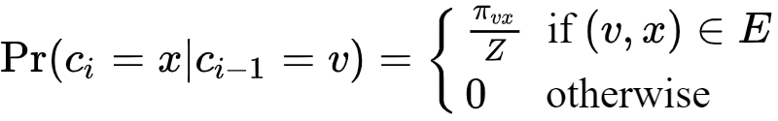
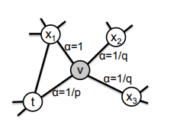
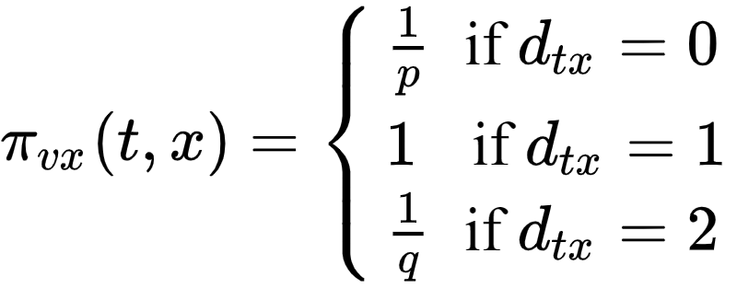
Node2Vec
Random walk is generated as a second order Markovian walk, with the next node depending on the current as well as previous node.
The transition probabilities are modelled as
Interpolate smoothly between BFS and DFS
Source: Node2Vec paper

Slide 5
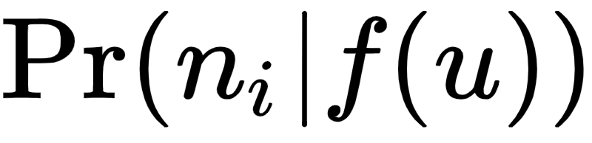
DeepWalk
A similar formulation is used as Node2Vec, but we do not use a BFS-DFS mechanism; the random walk is first order Markovian.
Hierarchical Softmax is used - vertices are assigned to the leaves of a binary tree, and the prediction problem turns into maximizing the probability of a specific path in the tree
Reduces the complexity of calculating from O(|V|) to O(log|V|)
In practice we observed DeepWalk was much faster than Node2Vec (more on that later)

Slide 6
Tasks
Pairwise node classification
Given two nodes, predict if they belong to the same class
Dataset - Protein
Link Prediction
To predict if there is an edge between two nodes
Dataset - Brightkite and PPI
Multi-class node classification
Assuming a node has multiple class labels associated with it, given a node, predict all it’s associated class labels.
Dataset - PPI

Slide 7
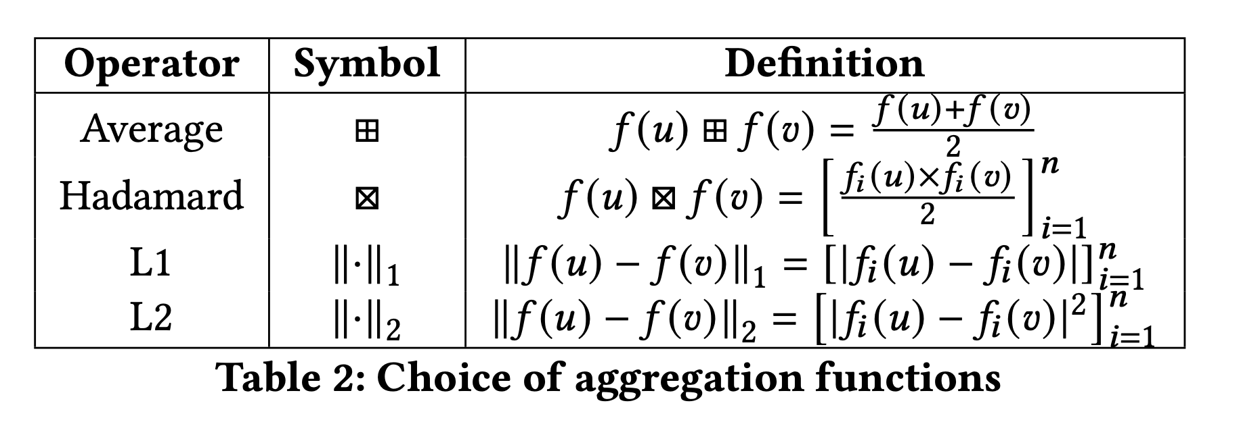
A note on Link-Prediction
Firstly, we only have node representations, not edge representations. We need some way of combining the node representations in some way to represent an edge.

Slide 8
A note on Link Prediction (continued)
Secondly, we follow a slightly different approach in dataset preprocessing for Link Prediction.
Given a graph G with edge E, sample 50% of the edges to obtain set E₁. Also sample ‘negative’ edges E_{neg}, i.e. edges between the nodes of G which are not present in E. The new training graph will be G’ with edge set E’ = E - E₁.
Learn node embeddings on G’. The edges in G’ comprise of ‘positive’ edges in the train set, while a portion of E_{neg} is designated as the negative edges in the train set.
To construct the test set, we sample positive edges from E₁ and negative edges from the remaining portion of E_{neg.}
Advantage: We sample true negative edges.
Disadvantage: Might not be practically feasible.

Slide 9
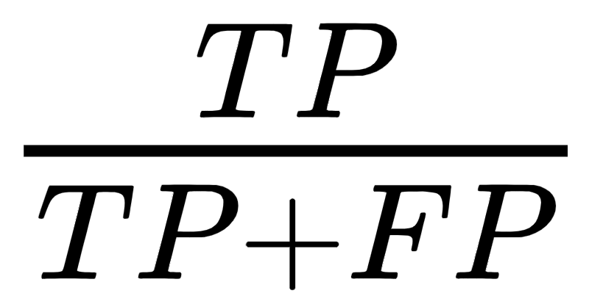
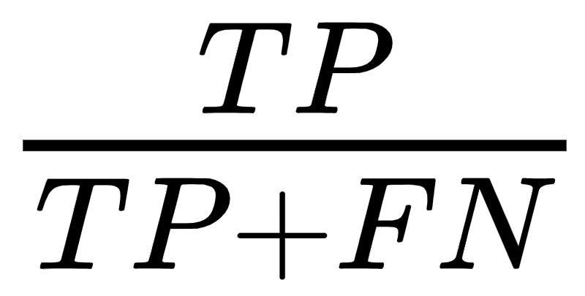
Scoring Methods
ROC AUC - Area under the true positive vs false positive rate curve plotted at different thresholds.
Precision- Given by the ratio . Low precision => high FPR.
Recall - It is the ratio . Low recall => high FNR.
F1 score -It is the harmonic mean of Precision and Recall

Slide 10
Implementation details
All experiments were carried out on Intel Xeon processors, running on Google Colab (Single core, 2 threads).
We perform 5-fold CV for all tasks except Link Prediction, because of added computational complexity.
We use a Logistic Regressor for Link Prediction and a Random Forest Classifier for Multi-Class classification and Pairwise Node Classification. All packages used were from scikit-learn library.

Slide 11
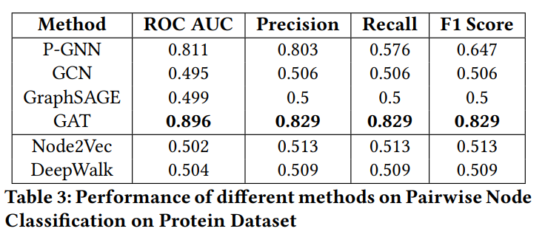
Results - Pairwise Node Classification
Both methods perform extremely poorly in this task.
Two possible reasons
Node2Vec and DeepWalk are task-agnostic, cannot exploit node labels.
Node labels do not depend heavily on structure of the graph.

Slide 12
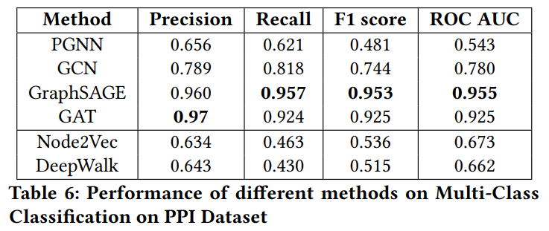
Results - Multi-class Classification
Better than pairwise classification performance but Node2Vec and DeepWalk no match.
We think the performance is low for similar reasons as before.

Slide 13
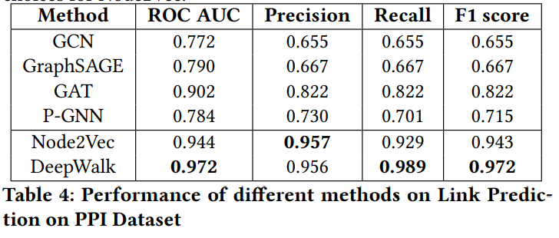
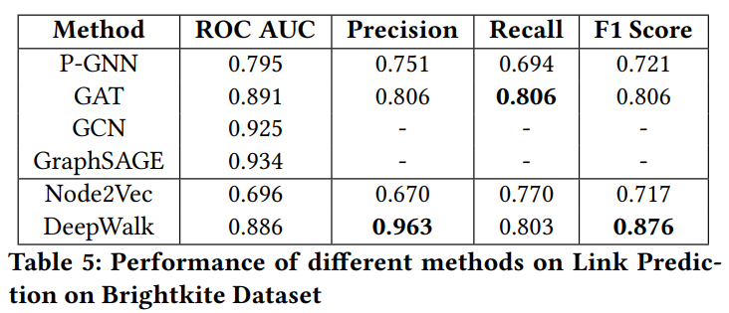
Results - Link Prediction
Surprisingly, Node2Vec and DeepWalk outperform other methods as well.
Two probable causes:
Our testing protocol is different.
This task especially depends on the structural properties of the graph, which is taken into account by these methods.

Slide 14
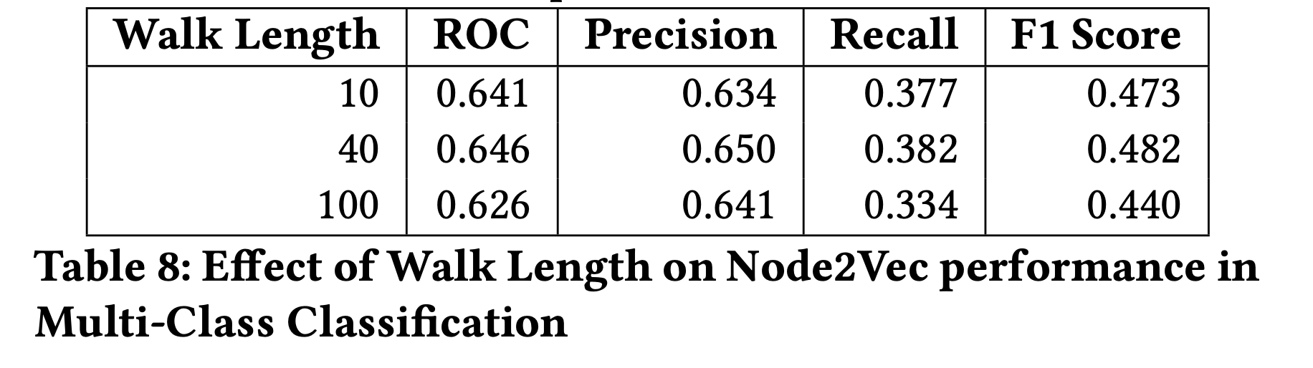
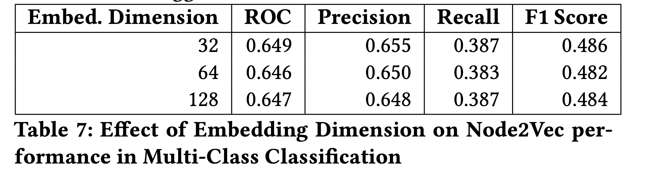
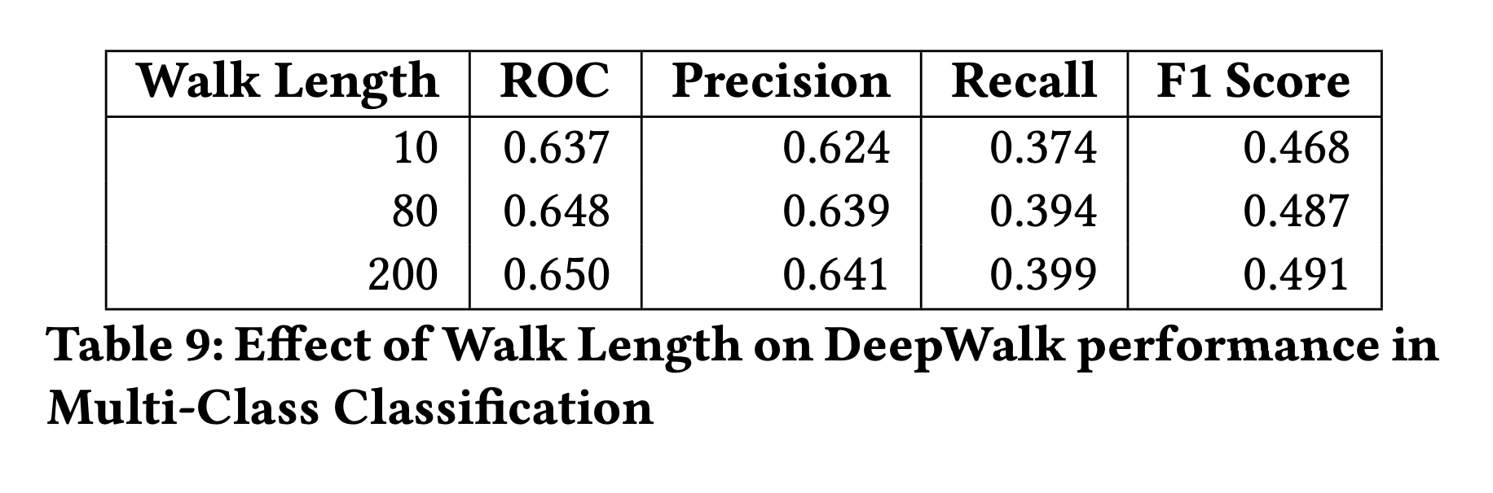
Effect of hyperparameters on performance
Embedding dimension Walk Length

Slide 15
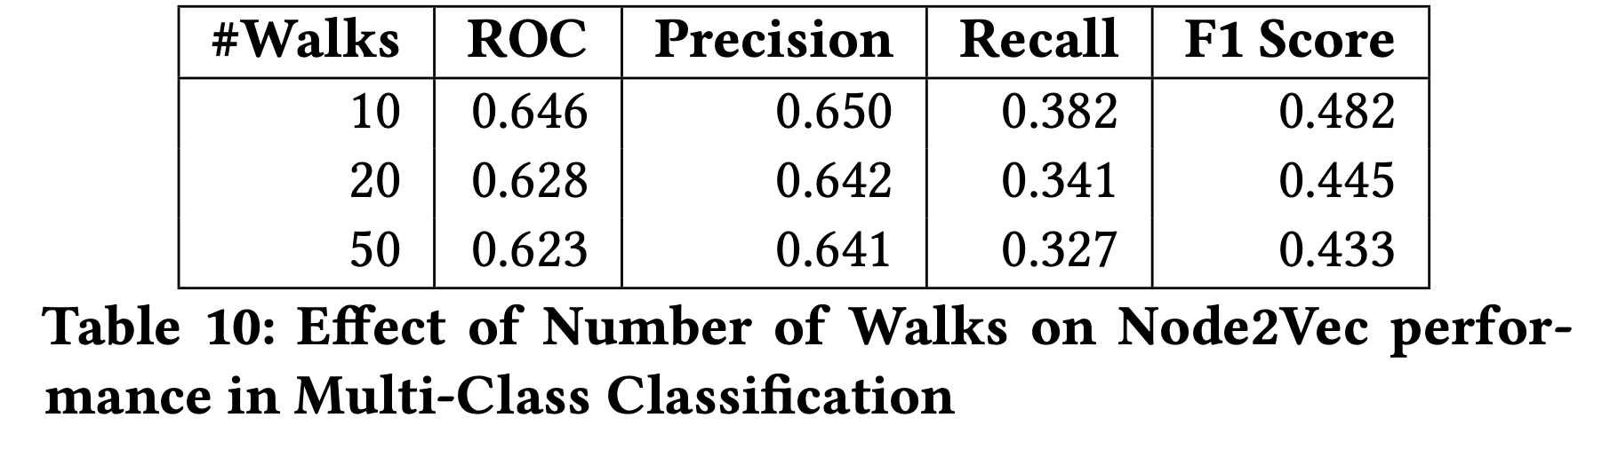
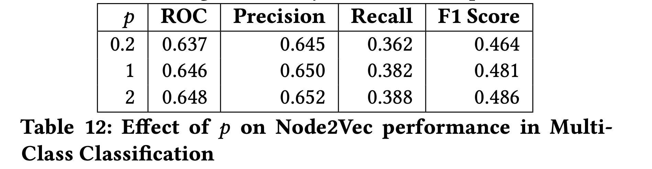
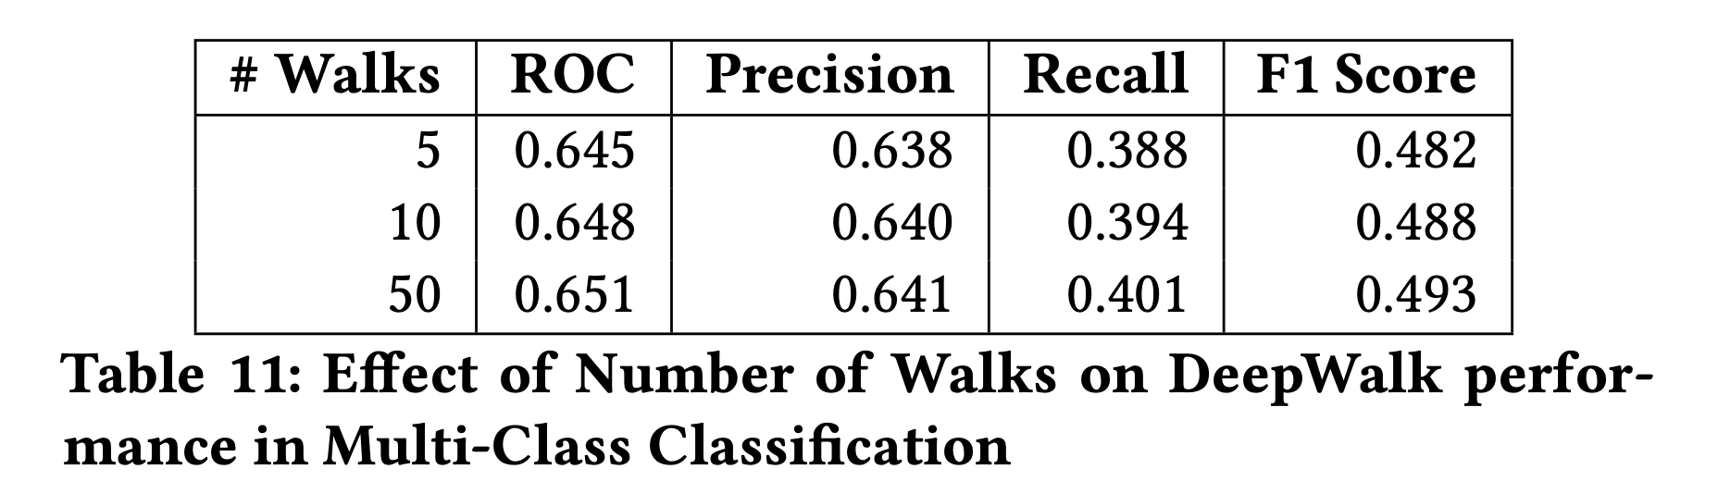
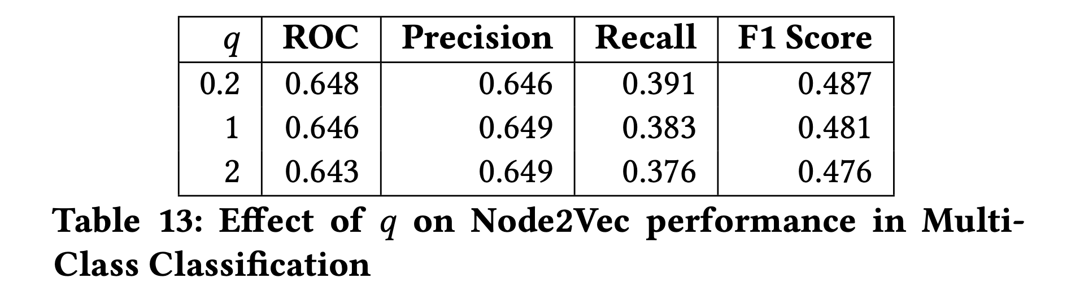
Effect of hyperparameters on performance (contd.)
Number of Walks Effect of p and q (Node2Vec)

Slide 16
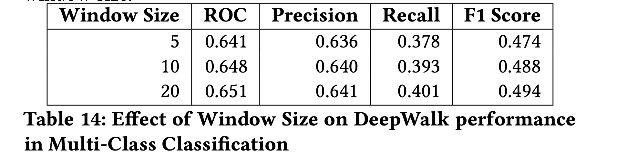
Effect of hyperparameters (contd.)
Window Size

Slide 17
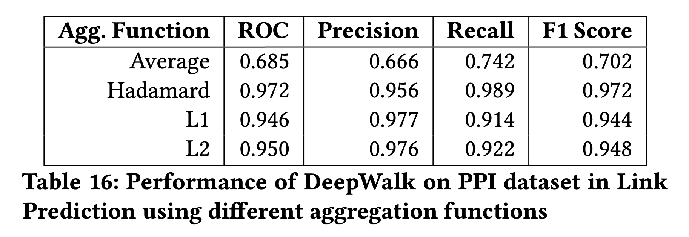
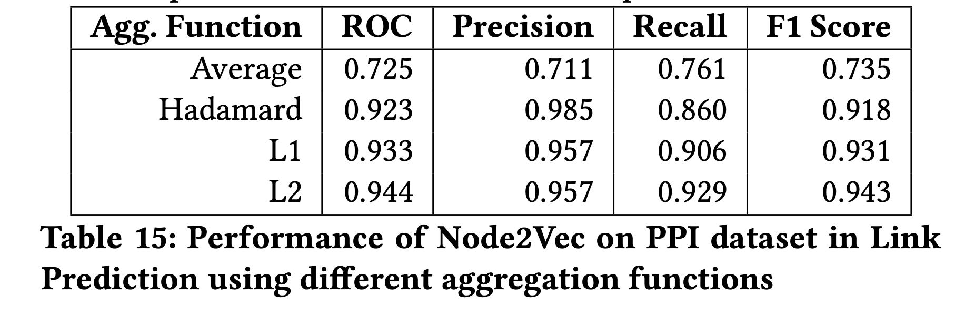
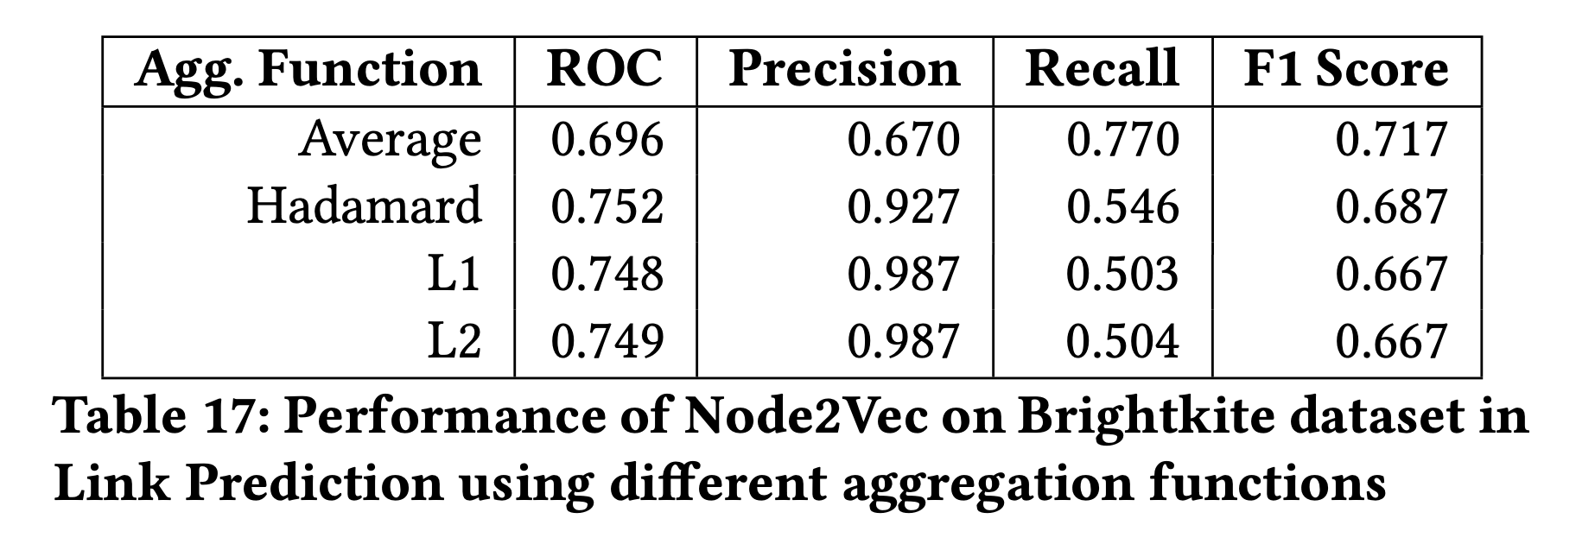
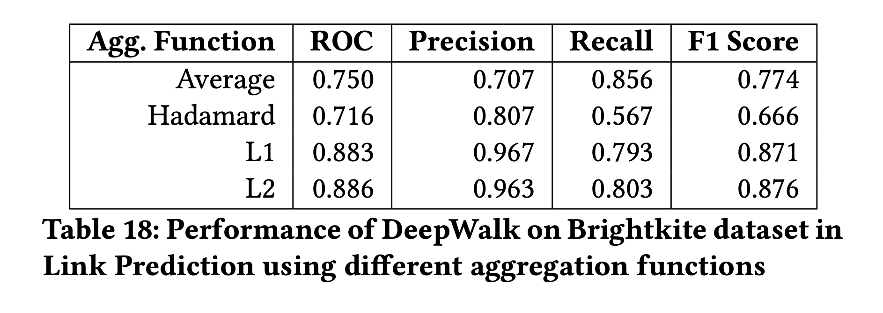
Effect of different aggregation functions in Link Prediction

Slide 18
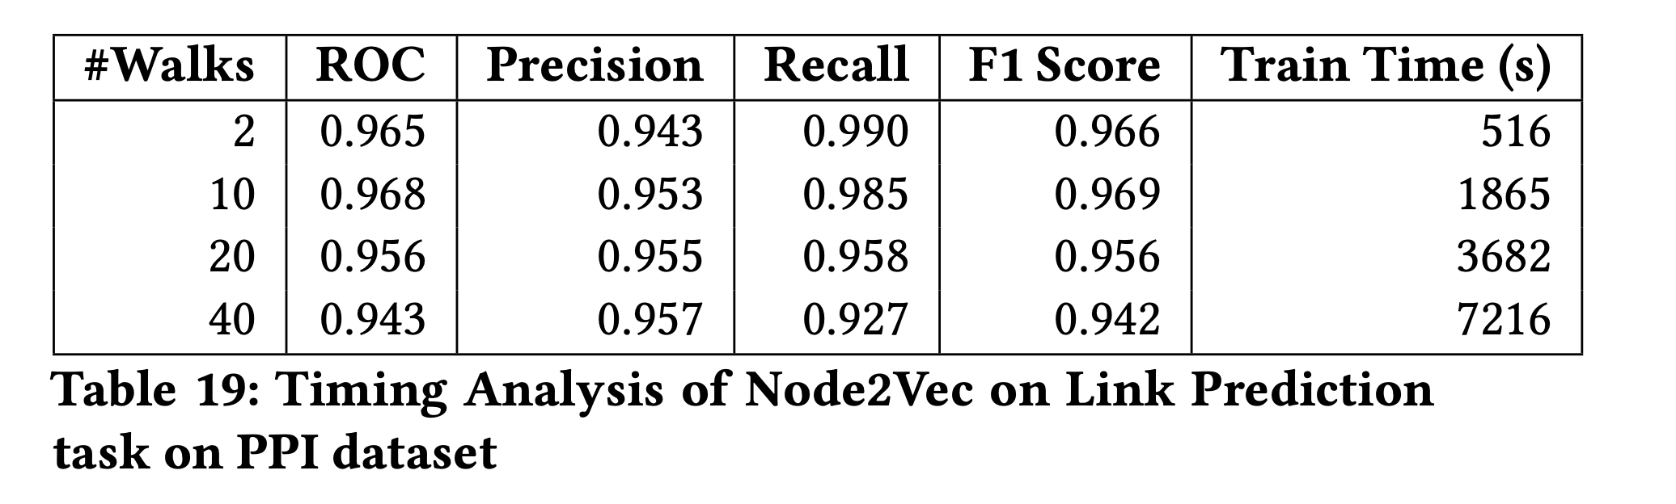
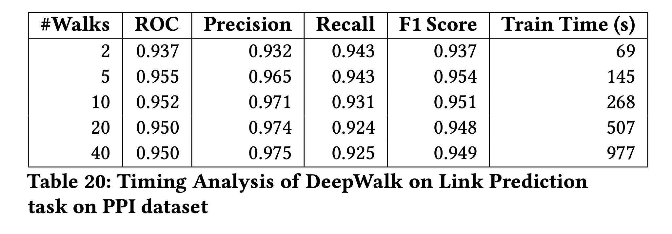
Timing Analysis
Since number of walks is the most time-sensitive parameter, we record time vs # Walks along with performance.
We notice no straightforward trend showing increased training time => better performance.
DeepWalk much faster than Node2Vec - might be due to implementation differences (e.g. binary tree optimization)

Slide 19
Conclusions
In most use-cases, contemporary inductive architectures like GCNs outperform Node2Vec and DeepWalk.
DeepWalk and Node2Vec - unsuited for datasets (like Proteins) where node labels are important informative features.
On the other hand, they might work better in scenarios where structural properties are more important (like in link prediction)
The trends reported in the original papers of the performance of these models with different hyperparameters, are not readily reproducible, and should be taken with a grain of salt.

Slide 20
Conclusions (contd.)
It is not necessarily the case that Node2Vec outperforms DeepWalk in all settings, however in most cases the difference in performance is marginal at best.
In most time-sensitive applications, DeepWalk seems to be a better choice than Node2Vec. Note, however, that this could be an implementation issue. We see no reason that the tree- based optimization cannot be applied on Node2Vec.

Slide 21
References
1] Karsten M Borgwardt and Hans-Peter Kriegel. 2005. Shortest-path kernels on graphs. In Fifth IEEE international conference on data mining (ICDM’05). IEEE, 8–pp.
[2] Eunjoon Cho, Seth A Myers, and Jure Leskovec. 2011. Friendship and mobility: user movement in location-based social networks. In Proceedings of the 17th ACM SIGKDD international conference on Knowledge discovery and data mining. 1082–1090.
[3] Aditya Grover and Jure Leskovec. 2016. node2vec: Scalable feature learning for networks. In Proceedings of the 22nd ACM SIGKDD international conference on Knowledge discovery and data mining. 855–864.
[4] William L. Hamilton, Zhitao Ying, and J. Leskovec. 2017. Inductive Representation Learning on Large Graphs. In NIPS.

Slide 22
References
[5] Hanqing Zeng et. al 2020. GraphSAINT: Graph Sampling Based Inductive Learning Method. In ICLR.
[6] Thomas Kipf and M. Welling. 2017. Semi-Supervised Classification with Graph Convolutional Networks. ArXiv abs/1609.02907 (2017).
[7] Bryan Perozzi, Rami Al-Rfou, and Steven Skiena. 2014. Deepwalk: Online learning of social representations. In Proceedings of the 20th ACM SIGKDD international conference on Knowledge discovery and data mining. 701–710.
[8] Petar Veličković, Guillem Cucurull, Arantxa Casanova, Adriana Romero, Pietro Lio, and Yoshua Bengio. 2017. Graph attention networks. arXiv preprint arXiv:1710.10903 (2017).

